Slide 1
Cryptography (2022 Fall) statistical distance, computationally indistinguishable, pseudorandom, PRG
LiangFeng Zhang
zhanglf@shanghaitech.edu.cn
SIST, ShanghaiTech

Slide 2
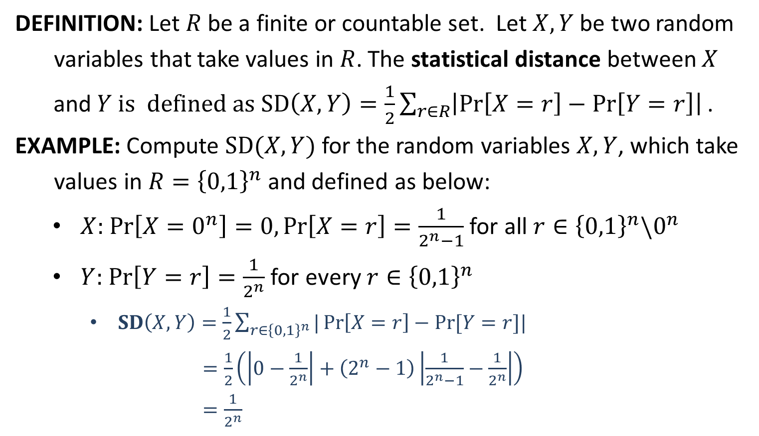
Statistical Distance
DEFINITION: Let $R$ be a finite or countable set. Let $X,Y$ be two random
variables that take values in $R$. The statistical distance between $X$
and $Y$ is defined as $SD\left(X,Y\right)=\frac{1}{2}\sum_{r∈R}{\left|\operatorname{Pr}\left[X=r\right]−\operatorname{Pr}\left[Y=r\right]\right| }$.
EXAMPLE: Compute $SD(X,Y)$ for the random variables $X,Y$, which take
values in $R={\left\{0,1\right\}}^{n}$ and defined as below:
$X:$ $\operatorname{Pr}\left[X=0^{n}\right]=0,\operatorname{Pr}\left[X=r\right]=\frac{1}{2^{n}−1}$ for all $r∈{\left\{0,1\right\}}^{n}\backslash 0^{n}$
$Y:$ $\operatorname{Pr}\left[Y=r\right]=\frac{1}{2^{n}}$ for every $r∈{\left\{0,1\right\}}^{n}$
$SD\left(X,Y\right)=\frac{1}{2}\sum_{r∈{\left\{0,1\right\}}^{n}}{|\operatorname{Pr}\left[X=r\right]−Pr⁡[Y=r]|}$
$=\frac{1}{2}\left(\left|0−\frac{1}{2^{n}}\right|+\left(2^{n}−1\right)\left|\frac{1}{2^{n}−1}−\frac{1}{2^{n}}\right|\right)$
$=\frac{1}{2^{n}}$

Slide 3
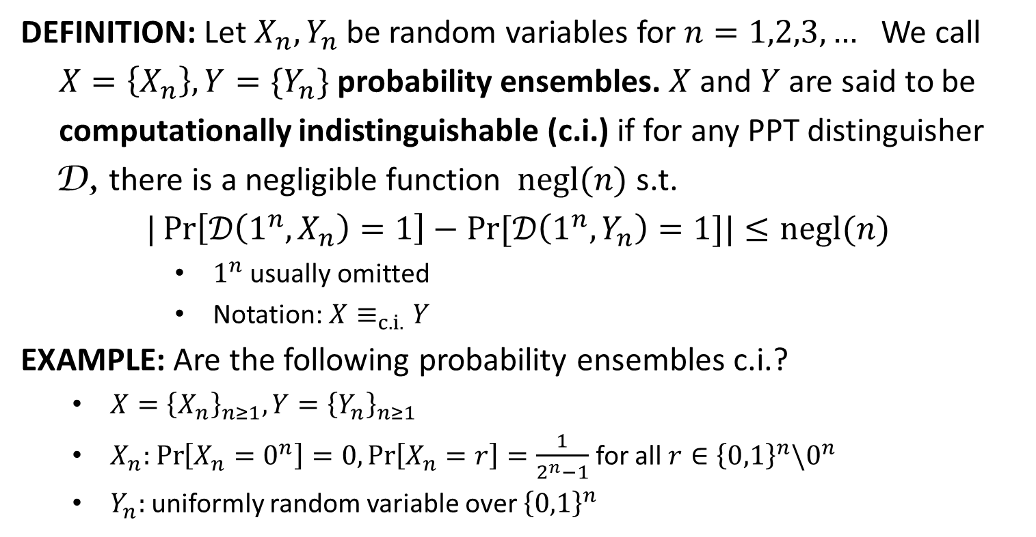
Computational Indistinguishability
DEFINITION: Let $X_{n},Y_{n}$ be random variables for $n=1,2,3,…$ We call
$X=\left\{X_{n}\right\}, Y=\{Y_{n}\}$ probability ensembles. $X$ and $Y$ are said to be
computationally indistinguishable (c.i.) if for any PPT distinguisher
D, there is a negligible function $negl(n)$ s.t.
$|\operatorname{Pr}\left[𝒟\left(1^{n},X_{n}\right)=1\right]−Pr⁡[𝒟\left(1^{n},Y_{n}\right)=1]|≤negl(n)$
$1^{n}$ usually omitted
Notation: $X≡_{c.i.}Y$
EXAMPLE: Are the following probability ensembles c.i.?
$X={\left\{X_{n}\right\}}_{n≥1}, Y={\left\{Y_{n}\right\}}_{n≥1}$
$X_{n}:$ $\operatorname{Pr}\left[X_{n}=0^{n}\right]=0,\operatorname{Pr}\left[X_{n}=r\right]=\frac{1}{2^{n}−1}$ for all $r∈{\left\{0,1\right\}}^{n}\backslash 0^{n}$
$Y_{n}:$ uniformly random variable over ${\left\{0,1\right\}}^{n}$

Slide 4
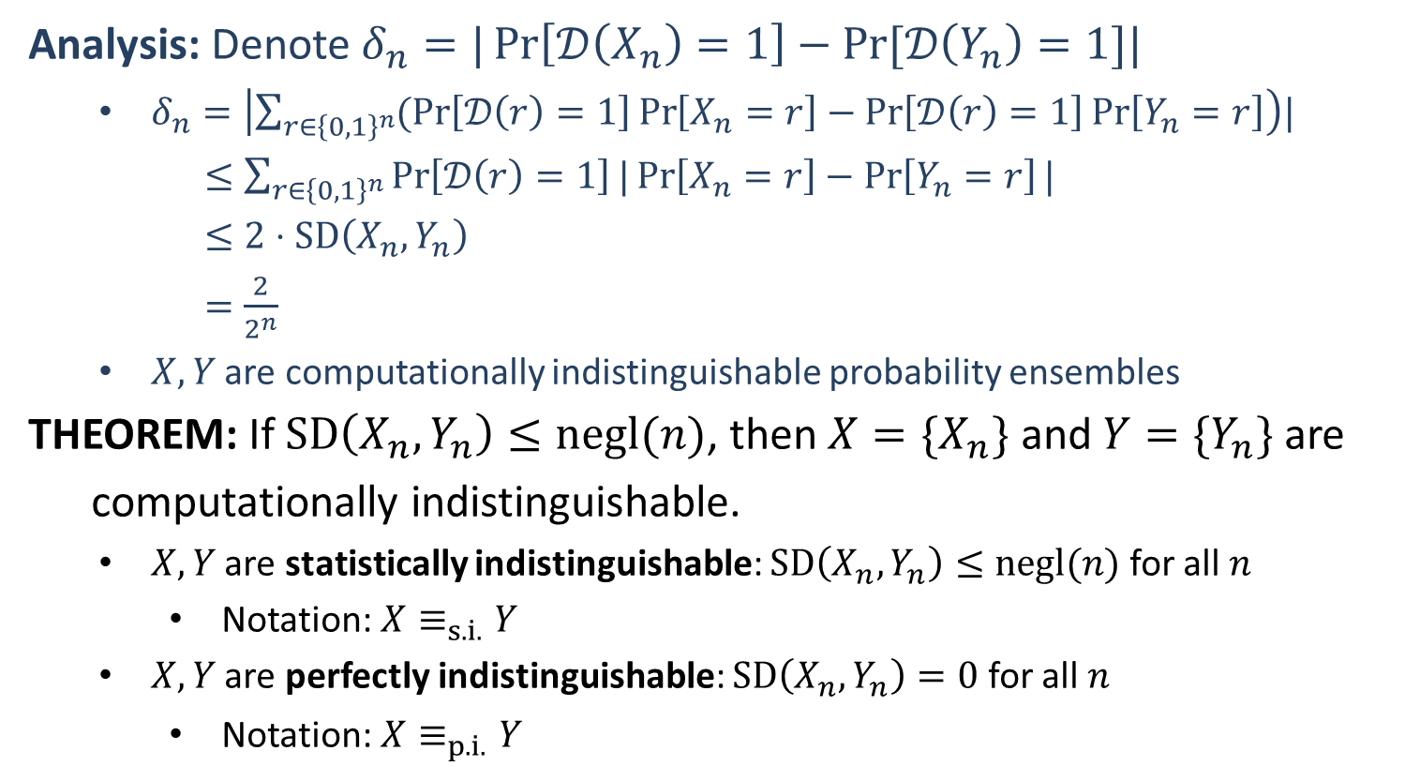
Computational Indistinguishability
Analysis: Denote $δ_{n}=|\operatorname{Pr}\left[𝒟\left(X_{n}\right)=1\right]−Pr⁡[𝒟\left(Y_{n}\right)=1]|$
$δ_{n}=\left|\sum_{r∈{\left\{0,1\right\}}^{n}}{(\operatorname{Pr}\left[𝒟\left(r\right)=1\right]}\operatorname{Pr}\left[X_{n}=r\right]−\operatorname{Pr}\left[𝒟\left(r\right)=1\right]\operatorname{Pr}\left[Y_{n}=r\right]\right)|$
$≤\sum_{r∈{\left\{0,1\right\}}^{n}}{\operatorname{Pr}\left[𝒟\left(r\right)=1\right]}|\operatorname{Pr}\left[X_{n}=r\right]−\operatorname{Pr}\left[Y_{n}=r\right]|$
$≤2⋅SD\left(X_{n},Y_{n}\right)$
$=\frac{2}{2^{n}}$
$X, Y$ are computationally indistinguishable probability ensembles
THEOREM: If $SD\left(X_{n},Y_{n}\right)≤negl(n)$, then $X=\{X_{n}\}$ and $Y=\{Y_{n}\}$ are
computationally indistinguishable.
$X,Y$ are statistically indistinguishable: $SD\left(X_{n},Y_{n}\right)≤negl(n)$ for all $n$
Notation: $X≡_{s.i.}Y$
$X,Y$ are perfectly indistinguishable: $SD\left(X_{n},Y_{n}\right)=0$ for all $n$
Notation: $X≡_{p.i.}Y$

Slide 5
Computational Indistinguishability
THEOREM: $X≡_{p.i.}Y⇒X≡_{s.i.}Y⇒ X≡_{c.i.}Y.$
$SD\left(X_{n},Y_{n}\right)=0⇒SD\left(X_{n},Y_{n}\right)≤negl\left(n\right)⇒X≡_{c.i.}Y$
We say that $p.i. ⇒s.i. ⇒c.i.$ (from strong to weak)
THEOREM: $X≡_{a}X$ for $a∈\{p.i., s.i., c.i.\}$
THEOREM: $X≡_{a}Y⇒Y≡_{a}X$ for $a∈\{p.i., s.i., c.i.\}$
$SD\left(X_{n},Y_{n}\right)=0⇒SD\left(Y_{n},X_{n}\right)=0$
$SD\left(X_{n},Y_{n}\right)≤negl\left(n\right)⇒SD\left(Y_{n},X_{n}\right)≤negl\left(n\right)$
$|\operatorname{Pr}\left[𝒟\left(X_{n}\right)=1\right]−Pr⁡[𝒟\left(Y_{n}\right)=1]|≤negl\left(n\right)⇒|\operatorname{Pr}\left[𝒟\left(Y_{n}\right)=1\right]−Pr⁡[𝒟\left(X_{n}\right)=1]|≤negl\left(n\right)$
THEOREM: $X≡_{a}Y, Y≡_{b}Z⇒X≡_{weak(a,b)}Z$, where
$weak\left(a,b\right)=\left\{\begin{aligned}a if b⇒a \\ b if a⇒b\end{aligned}\right.$ for all $a,b∈\{p.i., s.i., c.i.\}$.

Slide 7
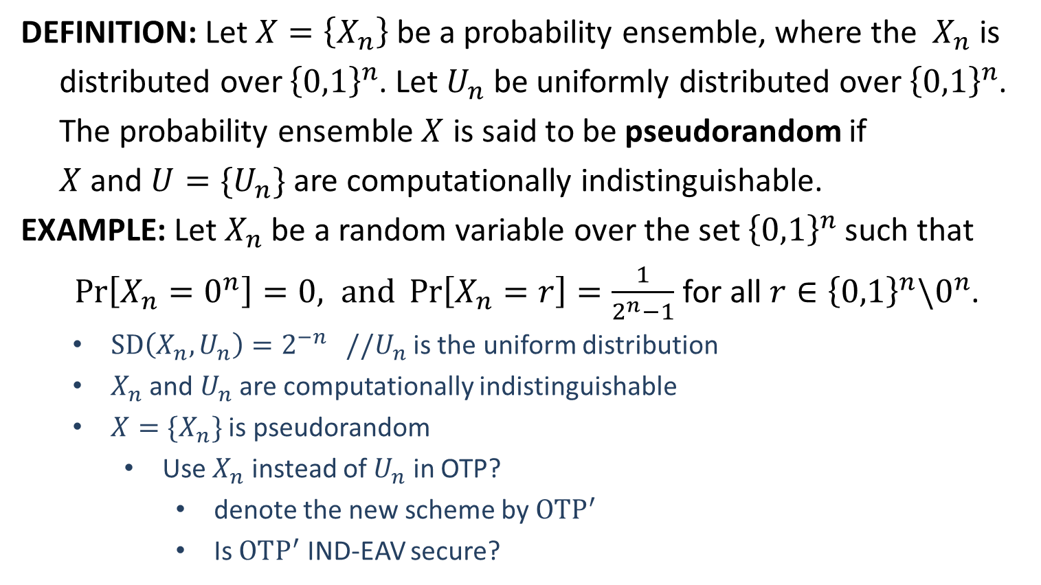
Pseudorandomness
DEFINITION: Let $X=\left\{X_{n}\right\}$be a probability ensemble, where the $X_{n}$ is
distributed over ${\left\{0,1\right\}}^{n}$. Let $U_{n}$ be uniformly distributed over ${\left\{0,1\right\}}^{n}$.
The probability ensemble $X$ is said to be pseudorandom if
$X$ and $U=\{U_{n}\}$ are computationally indistinguishable.
EXAMPLE: Let $X_{n}$ be a random variable over the set ${\left\{0,1\right\}}^{n}$ such that
$\operatorname{Pr}\left[X_{n}=0^{n}\right]=0, and \operatorname{Pr}\left[X_{n}=r\right]=\frac{1}{2^{n}−1}$ for all $r∈{\left\{0,1\right\}}^{n}\backslash 0^{n}$.
$SD\left(X_{n},U_{n}\right)=2^{−n}$ //$U_{n}$ is the uniform distribution
$X_{n}$ and $U_{n}$ are computationally indistinguishable
$X=\{X_{n}\}$ is pseudorandom
Use $X_{n}$ instead of $U_{n}$ in OTP?
denote the new scheme by $OTP^{′}$
Is $OTP^{′}$ IND-EAV secure?

Slide 8
IND-EAV from Pseudorandomness
$$m_{0},m_{1}$$
$$m_{0},m_{1}$$
$$k←X_{n}$$
$$k←{\left\{0,1\right\}}^{n}$$
$$c_{1}=k⊕m_{0}$$
$$c_{1}$$
$${c_{1}≡}_{s.i.}c_{2}$$
$$c_{2}=k⊕m_{0}$$
$$c_{2}$$
$$b^{′}$$
$$b^{′}$$
challenger
$$𝒜$$
challenger
$$𝒜$$
$${c_{1}≡}_{s.i.}c_{4}$$
$$c_{2}≡_{p.i.}c_{3}$$
$$m_{0},m_{1}$$
$$m_{0},m_{1}$$
$$k←X_{n}$$
$$k←{\left\{0,1\right\}}^{n}$$
$$c_{4}=k⊕m_{1}$$
$$c_{4}$$
$${c_{4}≡}_{s.i.}c_{3}$$
$$c_{3}=k⊕m_{1}$$
$$c_{3}$$
$$b^{′}$$
$$b^{′}$$
challenger
$$𝒜$$
challenger
$$𝒜$$
IND-EAV secure
$\left|k\right|=\log_{2}{(2^{n}−1)}<n$ bits
$$PrivK_{𝒜, OTP^{′}}^{eav}\left(n,b\right)$$
$$PrivK_{𝒜, OTP}^{eav}\left(n,b\right)$$

Slide 10
Pseudorandom Generator (PRG)
DEFINITION: A function $G:{\left\{0,1\right\}}^{n}→{\left\{0,1\right\}}^{l(n)}$ is called a pseudorandom
generator (PRG) if it satisfies the following conditions:
efficiently computable: there is a deterministic polynomial-time algorithm $D$ such that $D\left(x\right)=G(x)$ for all $x∈{\left\{0,1\right\}}^{n}$
expansion: $l\left(n\right)>n$ for all $n∈ℕ$
$l$is called the expansion factor of $G$
pseudorandomness: $G(U_{n})$ is pseudorandom, where $U_{n}$ is uniformly distributed over ${\left\{0,1\right\}}^{n}$
$∀$ PPT algorithm $𝒟$, $∃$ a negligible function $negl(⋅)$ s.t.
$|Pr⁡[𝒟\left(G\left(U_{n}\right)\right)=1]−Pr⁡[𝒟\left(U_{l(n)}\right)=1]|≤negl(n)$

Slide 11
Understanding PRG
REMARK: The output distribution of a PRG looks uniform.
EXAMPLE: The function $G:{\left\{0,1\right\}}^{n}→{\left\{0,1\right\}}^{n+1}$ defined by
$G\left(s_{1}s_{2}⋯s_{n}\right)=s_{1}s_{2}⋯s_{n}(⊕_{i}s_{i})$
is not a PRG.
Design a PPT algorithm $𝒟$ to distinguish between $G(U_{n})$ and $U_{n+1}$
INPUT: $x∈{\left\{0,1\right\}}^{n+1}$ // $x←G(U_{n})$ or $x←U_{n+1}$
Output $1$ if $x_{n+1}=⊕_{i=1}^{n}x_{i}$; otherwise, output $0$.
Analysis:
$Pr\left[𝒟\left(G(U_{n})\right)=1\right]=\underset{x←G(U_{n})}{Pr}\left[𝒟\left(x\right)=1\right]=1$
$Pr\left[𝒟\left(U_{n+1}\right)=1\right]=\underset{x←U_{n+1}}{Pr}\left[𝒟\left(x\right)=1\right]=\underset{x←U_{n+1}}{Pr}\left[x_{n+1}=⊕_{i=1}^{n}x_{i}\right]=\frac{1}{2}$
$|\operatorname{Pr}\left[𝒟\left(G\left(U_{n}\right)\right)=1\right]−Pr⁡[𝒟\left(U_{n+1}\right)=1]|=\frac{1}{2}$, non-negligible
$\{G\left(U_{n}\right)\}$ is not pseudorandom
$G$ is not a PRG

Slide 12
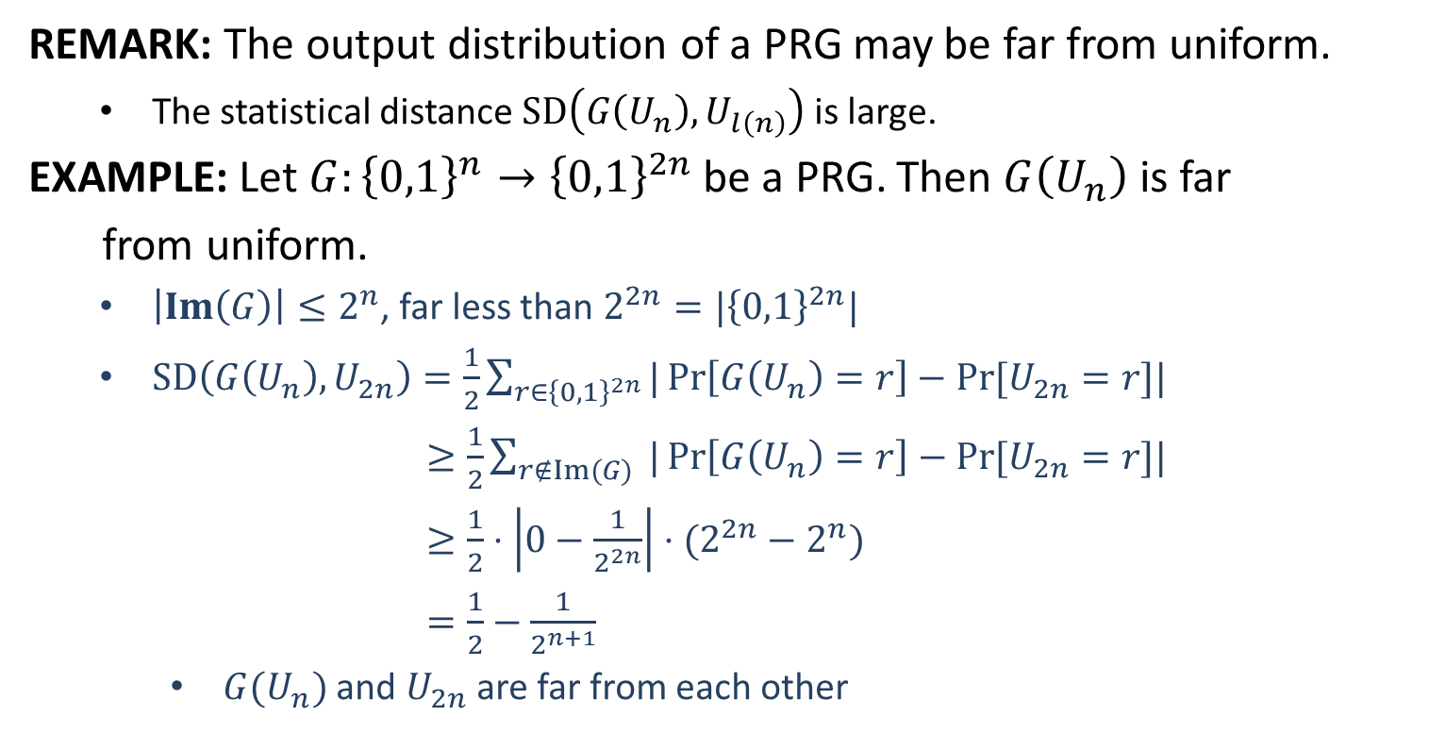
Understanding PRG
REMARK: The output distribution of a PRG may be far from uniform.
The statistical distance $SD\left(G\left(U_{n}\right), U_{l\left(n\right)}\right)$ is large.
EXAMPLE: Let $G:{\left\{0,1\right\}}^{n}→{\left\{0,1\right\}}^{2n}$be a PRG. Then $G\left(U_{n}\right)$ is far
from uniform.
$\left|Im\left(G\right)\right|≤2^{n}$, far less than $2^{2n}=|{\left\{0,1\right\}}^{2n}|$
$SD\left(G\left(U_{n}\right), U_{2n}\right)=\frac{1}{2}\sum_{r∈{\left\{0,1\right\}}^{2n}}{|\operatorname{Pr}\left[G\left(U_{n}\right)=r\right]−Pr⁡[U_{2n}=r]|}$
$≥\frac{1}{2}\sum_{r∉Im(G)}{ |\operatorname{Pr}\left[G\left(U_{n}\right)=r\right]−Pr⁡[U_{2n}=r]|}$
$≥\frac{1}{2}⋅\left|0−\frac{1}{2^{2n}}\right|⋅(2^{2n}−2^{n})$
$=\frac{1}{2}−\frac{1}{2^{n+1}}$
$G(U_{n})$ and $U_{2n}$ are far from each other

Slide 13
Understanding PRG
REMARK: Breaking PRG is trivial given unlimited computational power
EXAMPLE: Let $G:{\left\{0,1\right\}}^{n}→{\left\{0,1\right\}}^{2n}$be a PRG. Distinguish between
$G(U_{n})$ and $U_{2n}$ with unlimited computational power.
The distinguisher $𝒟$:
INPUT: $x∈{\left\{0,1\right\}}^{2n}, x←G(U_{n})$ or $x←U_{2n}$
$For$ $s∈{\left\{0,1\right\}}^{n}$ $do$
$If$ $G\left(s\right)=x$, $output 1;$
$Output 0.$
Analysis:
$\operatorname{Pr}\left[𝒟\left(G(U_{n})\right)=1\right]=\underset{x←G(U_{n})}{Pr}\left[𝒟\left(x\right)=1\right]=1$
$\operatorname{Pr}\left[𝒟\left(U_{2n}\right)=1\right]=\underset{x←U_{2n}}{Pr}\left[𝒟\left(x\right)=1\right]=\underset{x←U_{2n}}{Pr}[x∈Im(G)]$ $≤\frac{2^{n}}{2^{2n}}=2^{−n}$
$|\operatorname{Pr}\left[𝒟\left(G\left(U_{n}\right)\right)=1\right]−Pr⁡[𝒟\left(U_{2n}\right)=1]|≥1−2^{−n}$
$𝒟$distinguishes with non-negligible (very large) probability

Slide 14
Understanding PRG
REMARK: The seed $s$ must be long enough
$\left|s\right|=n:$ any distinguisher can run a brute-force attack as below
$for s^{′}∈{\left\{0,1\right\}}^{n} do$
$if G\left(s′\right)=G\left(s\right), then output s^{′}$
Usually we choose $|s|$ to be the security parameter
REMARK: The seed $s$ must be chosen uniformly and kept secret
If the seed $s$ is not uniform, no guarantee of $G\left(s\right)≡_{c.i.} U_{l(n)}$
If the seed $s$ is public, $G(s)$ is public and not useful.

